Slide 1
Forestry in the ETS 101

Slide 2
Overview of the ETS
Waste
ETS is NZ’s primary action to reduce net emissions and meet climate change targets
Forestry
The Emissions Trading Scheme
Acts as NZ’s domestic carbon market
Energy
Fossil fuels
Different to what NZ reports on and accounts for internationally for emissions
Industrial processing
Agriculture – reporting emissions only, He Waka Eke Noa
Notes:
The ETS:
The ETS was set up in 2008 to meet New Zealand’s international climate change commitments
The ETS is New Zealand’s domestic carbon market. The market sets a price for greenhouse gases to discourage emissions and encourage carbon storage – the idea is that both of these together will drive down net emissions.
New Zealand chose to implement a market mechanism to incentivise emissions reductions domestically – this is the ETS. Some other countries also implemented market mechanisms: the EU operates a ‘cap and trade’ ETS and there are similar examples used in California and Quebec. Other common tools to reduce emissions domestically include taxation and regulation of emitters and subsidies to incentivise emissions reductions.
International obligations:
Our initial obligations were made under the Kyoto Protocol
In 2016, New Zealand ratified the Paris Agreement, under which we set a target of reducing our net greenhouse gas emissions by 30% from 2005 levels for the period 2021-2030
Sectors included in the ETS
New Zealand reports internationally on greenhouse gas emissions and storage from all sectors. However, we only agreed to count some of those sectors and gasses towards our net emissions target, where we had good evidence of baseline levels.
The five sectors fully included in the ETS for the domestic market are forestry, waste, stationary energy, liquid fossil fuels, and industrial processing.
The agricultural sector is currently not required to account for its emissions. However, there is a sector-led work programme (He Waka Eke Noa) in place to reduce net emissions from agriculture as an alternative to joining the ETS in 2025.

Slide 3
How does the ETS Forestry work?
NZU
$85
$
$61
Emitters
Sequesters
Notes:
The NZ ETS is a market mechanism with buyers and sellers of carbon.
Sequesters (storers of carbon such as new forest owners) are the seller in the market.
They can earn NZUs from the government for storing carbon which they can choose to hold on to or sell on the market.
Emitters are the buyer in the carbon market. They are obligated to surrender NZUs to the government to cover their emissions.
They must purchase NZUs from the market at the market price
Emitters were given an allocation of units when they first came into the scheme.
The currency used is the New Zealand Unit (NZU), otherwise known as carbon credits.
1 NZU is worth 1 tonne of CO2 equivalent, and NZUs are traded through the Emissions Unit Register.

Slide 4
Exotic Forest historic rate of planting
Third planting boom
Carbon Farming boom
State Forest Service 1919
Second planting boom
First planting boom
Data from the 2016 National Exotic Forest Description
Notes:
Start of planting boom 1:o State Forest Service Establishe1919 – Name change 1949 to New Zealand Forest Service, NZIF Established, Forests Act 1921-22
Start of planting boom 2: Canterbury School of Forestry established, NZ Forest Owners Association established
Planting boom 3: 1987 Privatization of Forest Assets, 1991 NZ Forest Accord signed, CRI’s established
NZ Perpetual Forests latter became NZ Forest Products – Kinleith Forests (170,000 ha)

Slide 5
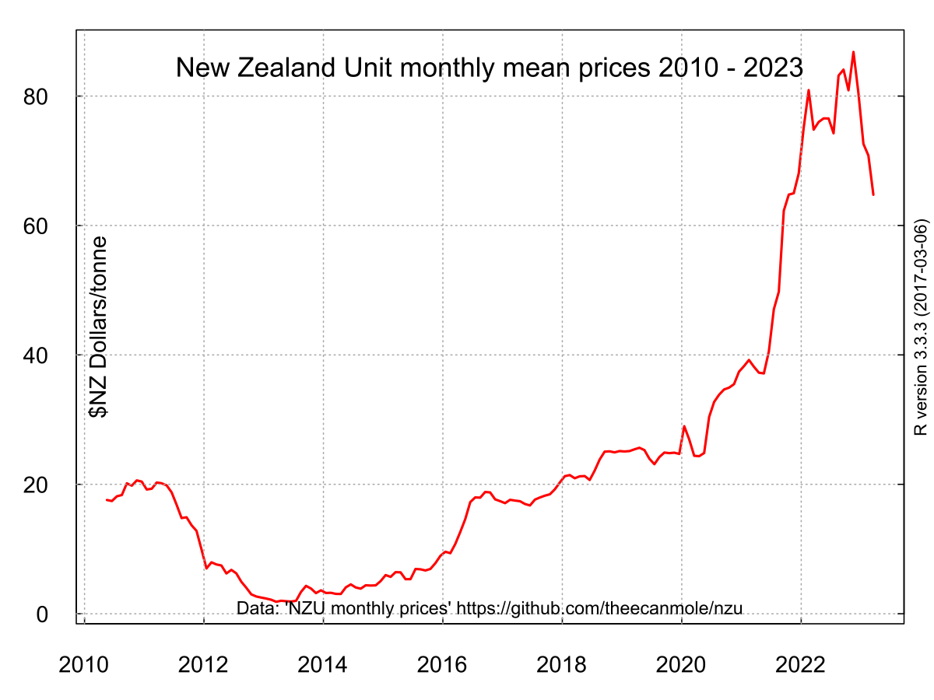
First NZU auction
NZ ETS shut off from international markets
Paris Agreement ratified
Policy changes to ETS passed
$41.00
29 June 2023
$61.00
9 August 2023
2021

Slide 6
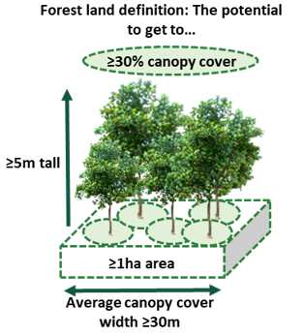
What is forest land in the ETS?
There is a specific definition of forest land in the ETS. This differentiates between land being used as a forest and other trees in the landscape.
Forest must be made up of 1 ha or more of forest species – a forest species is one that can grow to at least 5m height at maturity where it’s located.
Likely to achieve a tree canopy cover of at least 30% in each hectare at maturity.
Can achieve an average tree canopy width of at least 30m at maturity.
Notes:
Speaker:
The settings for forestry in the ETS are very similar to the settings NZ chose to account for internationally. The intention was that only land being primarily used as a forest would be included in the ETS, and that other trees in the landscape that weren’t primarily forests, e.g. shelterbelts, fruit or nut crops, would not be captured. This is consistent with the objective of the CCRA and the ETS to help NZ reach its international targets.
The definition used for forest land in the ETS has three criteria:
The forest must be made up of 1 ha or more of forest species – a forest species is one that can grow to at least 5m height at maturity where it’s located. Does not include fruit or nut crops.
The forest must be likely achieve a tree crown cover of at least 30% in each hectare. Trees should also be less than 15m apart.
The forest must be able to achieve an average tree crown width of at least 30m at maturity. Unless contiguous to another area of forest.
Forest definition is two parts: meets the above, or did meet, been cleared and has not changed to a different land use.
On the next slide, we will show you an example of forest land that meets the criteria set out above.

Slide 7
Two kinds of forest
The baseline date for net emissions is 1 January 1990 – agreed in the Kyoto Protocol – this creates two kinds of forest which are treated differently in the ETS.
Pre-1990
Post-1989
Forest established before 1 January 1990 and land still in exotic forest on 31 December 2007 (native forest not covered – managed through RMA and Forests Act)
Counted as part of NZs baseline carbon stock – can’t earn any units from ETS
Can harvest, replant and change species without ETS obligations
Must pay units to the Govt if deforested
Participation is mandatory – only if deforested
Exotic/native forest established after 31 December 1989
Additional carbon storage above the baseline
Earn units for forest growth
Obligations if harvested
Must pay back all units if deforested
Participation is voluntary – need to register

Slide 8
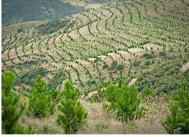
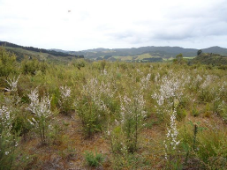
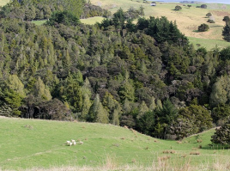
Examples of post-1989 forest eligibility
20 hectares radiata pine planted in July 1994 into paddocks grazed since the 1960s. Livestock numbers before planting were enough to stop regeneration of any forest species.
5ha back paddocks grazed since the 1970s, with enough livestock to stop growth of any forest species. Livestock were removed in early 1993 and extensive mānuka seedling regeneration visible over the whole area by 1996.
5ha gully originally indigenous forest but was converted to farmland in the 1930s. It was farmed until the early 1980s then abandoned and was left to revert to indigenous forest and is still in forest today.
‘Post-1989’ forest land, established in July 1990
‘Post-1989’ forest land, established in 1996
Indigenous forest established before 1990 - NOT ‘post-1989’ forest land

Slide 9
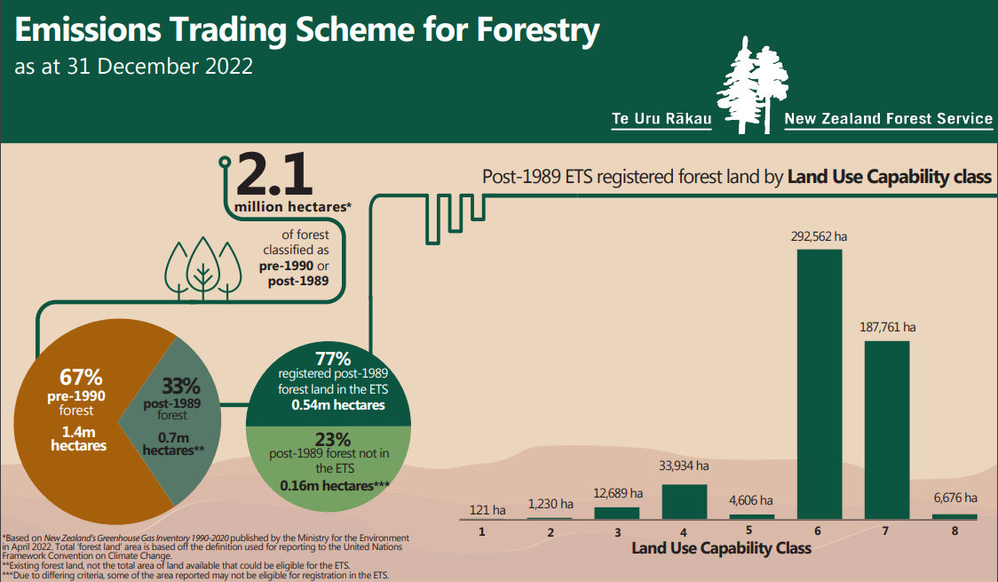
The scale of forestry in the NZ ETS
Notes:
​

Slide 10
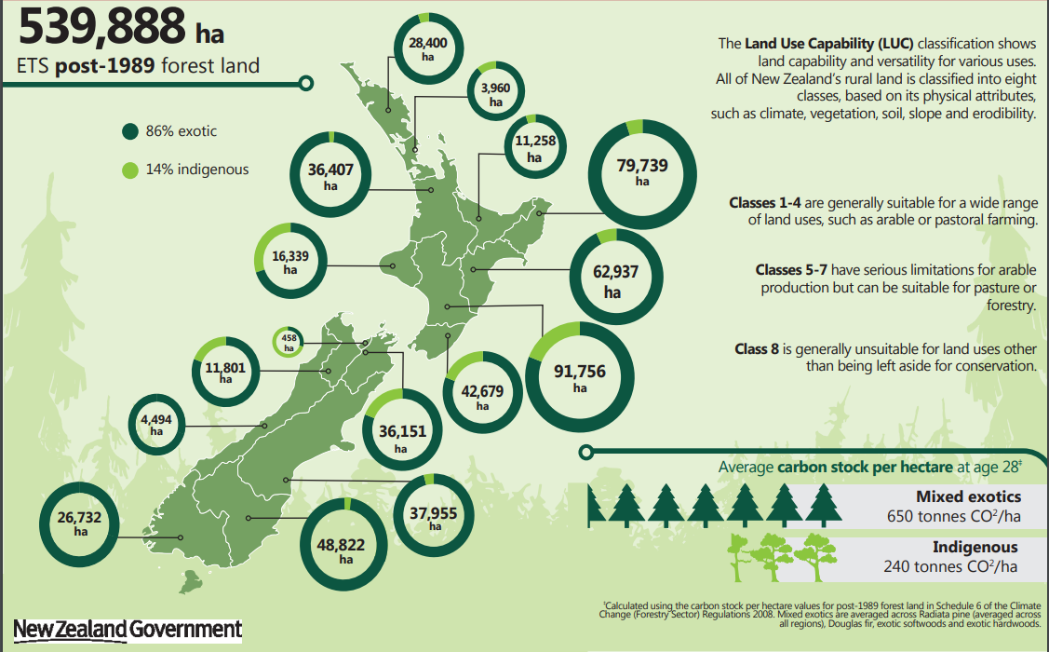
The scale of forestry in the NZ ETS
75,500 ha
Notes:
280,000ha​
Approximately 50% of registered P89 along the East Coast

Slide 11
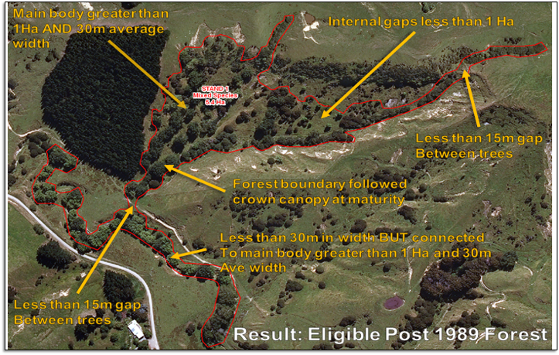
Notes:
Speaker:
<Some notes below from Steven Cox MPI ETS public presentation>
This image is an example of the concepts previously mentioned that will meet post-1989 forest land in the ETS
Remember that to be eligible to earn carbon credits the planted area must meet certain criteria.
[Flick through the criteria as they have been covered already]
The forest land is made up of 1 ha or more of forest species – a forest species is one that can grow to at least 5m height at maturity where it’s located.
The forest has achieved a crown cover of at least 30% in each hectare at maturity. Trees are less than 15m apart.
The forest must be able to achieve an average tree crown width of at least 30m at maturity. Unless contiguous to another area of forest
Post-1989 first established
However, there is a lot of flexibility in how you meet the criteria. Be strategic about the planting you do on farm to give yourself the option of earning carbon credits should you choose. Often it’s down to planting only a few more trees – Google Earth is a useful tool to map out potential planted areas to give an idea of size and width.
Example 1: Connect up narrow or small planted areas such as riparian buffers, shelterbelts and wetlands to bigger planted areas such as forests and gullies – so long as all of it was established after 1990 then doing this increases the average width and overall size to meet these criteria. Interplant with trees species if needed to meet the 30% crown cover criteria. Note that narrow areas can be difficult to see from aerial imagery so make sure you take lots of photos when you register.
Example 2: If you are space planting poplars and willows for erosion control, consider planting a few more to connect up gully arms to create a much larger overall area. [The area pictured is registered in the ETS]
Example 3: Establish multiple age classes of woodlots, or register both permanent and rotation forests to maximise the amount of ‘low risk units’ in your portfolio.

Slide 12
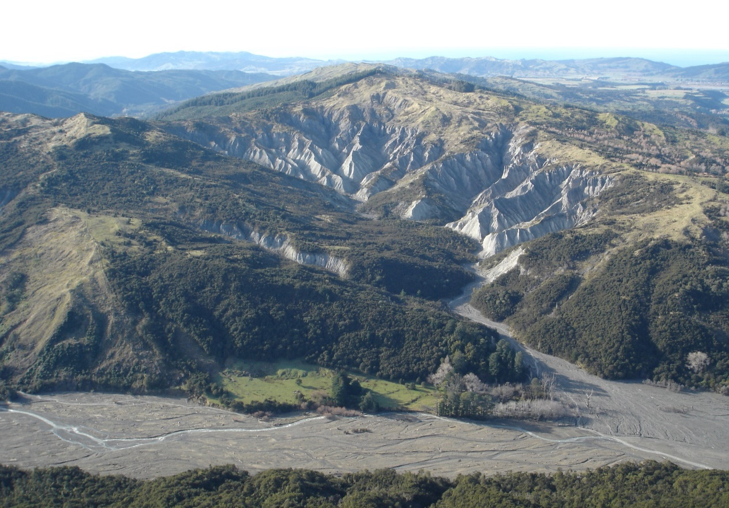
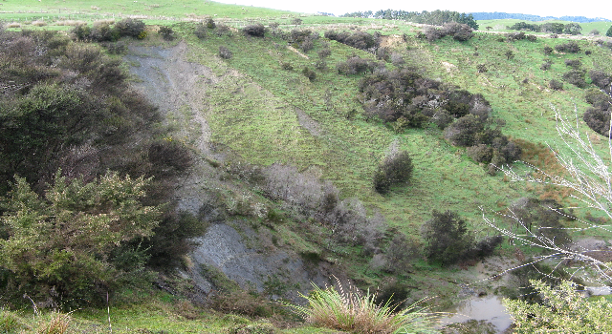
Registering post-89 forest in the ETS
Get consent
Open a holding account
Map your forest
Apply to register with MPI
Submit to MPI

Slide 13
Accounting options for post-1989 forests
There are different options for how you account for carbon that will impact how and when you earn units
All forests use stock change accounting
If you register between 1 January 2019 and 31 December 2022
Account for short-term increases and decreases in carbon stock in the forest
One off chance to switch in 2023
Can switch any time from 2023
Standard forests use averaging accounting
Permanent forests use stock change accounting
If you register from 1 January 2023
Account for long-term average carbon stock in the forest
Account for short-term increases and decreases in carbon stock in the forest
Can switch any time from 2023
Notes:
From January 2023 there will be a new way to account for the carbon stored in forests, called averaging accounting.
For forests registered between 2019 and 2022 you will have the option of staying with the current way we account for carbon – the ‘stock change’ method, or making a switch to averaging
For forests that register from 2023, you will only be able to use averaging accounting, unless you register as a permanent forest.
Note – at this stage forests registered before 2019 must stay on stock change, but Cabinet will be revisiting this decision end of 2021

Slide 14
Stock change accounting
Until 31 December 2022, all post-1989 forests in the ETS accounted for carbon using the stock change approach.
Pay most units back after harvest to account for loss of carbon in logs, roots, stumps, etc
Earn units as 1st rotation grows from when it is registered
Earn units as 2nd rotation grows
Carbon stock in the forest
If forest is replanted, carbon stock doesn’t return to zero. These units are “low-risk” as they don’t need to be paid back after harvest.
Growth of new rotation
Notes:
As we looked at before, stock change accounting looks at increases and decreases of carbon stored within forest land over time.
So here we can see carbon stock increases as the forest is grown, then decreases sharply when the forest is harvested. The carbon stock doesn’t drop to zero at harvest because of the residual carbon that we talked about before, which decays over the next ten years. As the new forest is planted and begins to sequester carbon, we see the carbon stock of the forest increase again.
NZUs are allocated to the participant for increases in carbon, and the participant is required to surrender units when carbon stock decreases.
<Notes taken from Steven’s MPI public presentation>
Earning and surrendering NZUs
Under stock change accounting, you earn units as your forest grows and stores carbon, and you pay back units to the Government if the carbon in your forest decreases.
Around 60% of the units you’ve earned will need to be surrendered immediately after harvest. You then continue to repay units to account for the decay in woody debris.
If you replant, the new growth from your second rotation will overtake the decay in your previous rotation, and you will begin earning units again (usually in about 10 years, depending on when you replant).
Low-risk units
Because the carbon in your forest doesn’t return to zero, there is a portion of units (called “low risk” units) that don’t need to be paid back to the Government (unless you deforest/de-register).
To have any of these units left-over after harvest, the forest must have been registered at a young age and be earning units in the ETS early (usually when the forest is below 10 years of age), otherwise all units will need to be paid back to the Crown.
If your forest had been previously harvested before it was registered in the ETS, there will be no “low-risk” units from the stock change method.

Slide 15
Accounting for standard forests from 2023
All standard post-1989 forests registered from 1 January 2023 will use averaging accounting and forests that registered between 1 January 2019 and 31 December 2022 can opt in.
Earn units on 1st rotation from registration until forest reaches long-term average carbon stock
Don’t earn or pay units
The details of how averaging accounting will work were announced on the 8th of October
Carbon stock in the forest
Long-term average carbon stock
The age the forest reaches its long term average carbon stock is its “average age”
Amount of “low-risk” units that don’t need to be paid back after harvest is larger
Notes:
Under the new averaging accounting method, the government only issues NZUs up until the average age of the particular type of tree species.
The average age is different for different types of forest. For Pinus Radiata this is around 16-17 years.
After a forest reaches its average age, participants will no longer earn units, but will also no longer be required to rep[ay units when the forest is harvested, so long as the forest is replanted within four years.
<Notes taken from Steven’s public presentation>
Earning and surrendering NZUs
Under averaging accounting, you earn units up until the forest stores the amount of carbon equivalent to it’s long term average carbon stock over several rotations of growth and harvest.
The age the forest reaches this point is called its “average age”
The average age will be different for different types of forests – for radiata it will be around 16-17 years
After the forest reaches its average age it will stop earning units
When the forest is harvested, usually no units will be owed
Low-risk units
Because units don’t need to be paid back after harvest, the amount of low-risk units earned under averaging is larger than under stock change –
A key difference with stock change is that units are front-loaded to the start of the first rotation, and later rotations typically won’t earn any units.
Note – the details of how averaging will work in practice are still being decided, but final decisions are expected in mid-2021.

Slide 16
Accounting for permanent forests from 2023
The Permanent Post-1989 category is available from 1 January 2023, forests already registered in the ETS can opt-in to the permanent category at any time.
Earn low risk units from registration for 50 years
Choice of:
Register into the permanent category for minimum of 50 years
Must remain in forest for entire period – max selective harvest to 30% canopy cover
Penalty for excess harvest
Earn tagged ‘permanent’ units
25 more years
Switch to averaging - pay units to the average
Exit – pay all units back
Notes:
Finally we have the permanent forest category.
To enter the permanent forest category participants need to commit to not clear felling their forest for at least 50 years, although some limited harvesting is allowed.
As you can see on the right side of the graph there, at the end of 50 years in the permanent forest category, participants have three choices:
To opt into another 25 years in the permanent forest category,
To switch to averaging accounting, at which time they will have to repay NZUs back to the average age of the forest, or
To repay all of their units and exit the emissions trading scheme.
<Notes taken from Steven’s public presentation ppt>
From January 2023, people will be able to register new and existing forests into the permanent category.
Participants will need to commit for a minimum of 50 years and won’t be able to clear-fell harvest during that time (some limited harvesting is allowed)
Participants in the permanent category will earn tagged ‘permanent’ units that can de differentiated from units earned by rotational forests.

Slide 17
Average age and tonnes different species
Radiata Pine Age 16 205 – 396
Douglas-fir Age 26 436
Exotic Softwoods Age 22 344
Exotic Hardwoods Age 12 320
Native (indigenous) Age 23 194
Can replant a different species or harvest at a different age during latter rotations without having to pay units
Notes:
Massive variation in average carbon for radiata from 205 tonnes Canterbury/West Coast to 396 tonnes Auckland

Slide 18
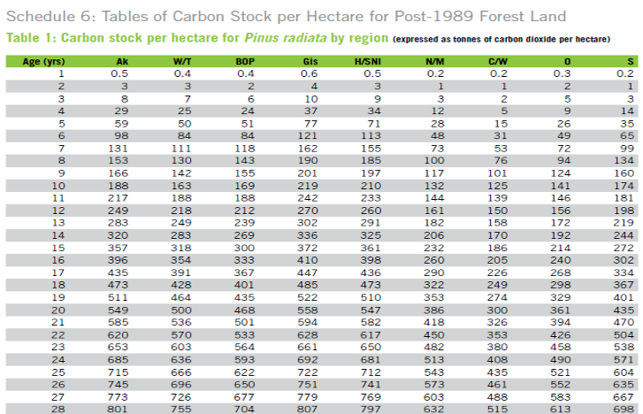
Default Look-up Tables
Carbon Stock Start Period
Carbon Stock End Period
Increase claimed 166
Will apply to less than 100 ha forests

Slide 19
What is forest land in the ETS?
There is a specific definition of forest land in the ETS. This differentiates between land being used as a forest and other trees in the landscape.
Forest must be made up of 1 ha or more of forest species – a forest species is one that can grow to at least 5m height at maturity where it’s located.
Likely to achieve a tree canopy cover of at least 30% in each hectare at maturity.
Can achieve an average tree canopy width of at least 30m at maturity.
Notes:
Speaker:
The settings for forestry in the ETS are very similar to the settings NZ chose to account for internationally. The intention was that only land being primarily used as a forest would be included in the ETS, and that other trees in the landscape that weren’t primarily forests, e.g. shelterbelts, fruit or nut crops, would not be captured. This is consistent with the objective of the CCRA and the ETS to help NZ reach its international targets.
The definition used for forest land in the ETS has three criteria:
The forest must be made up of 1 ha or more of forest species – a forest species is one that can grow to at least 5m height at maturity where it’s located. Does not include fruit or nut crops.
The forest must be likely achieve a tree crown cover of at least 30% in each hectare. Trees should also be less than 15m apart.
The forest must be able to achieve an average tree crown width of at least 30m at maturity. Unless contiguous to another area of forest.
Forest definition is two parts: meets the above, or did meet, been cleared and has not changed to a different land use.
On the next slide, we will show you an example of forest land that meets the criteria set out above.

Slide 20
Two kinds of forest
The baseline date for net emissions is 1 January 1990 – agreed in the Kyoto Protocol – this creates two kinds of forest which are treated differently in the ETS.
Pre-1990
Post-1989
Forest established before 1 January 1990 and land still in exotic forest on 31 December 2007 (native forest not covered – managed through RMA and Forests Act)
Counted as part of NZs baseline carbon stock – can’t earn any units from ETS
Can harvest, replant and change species without ETS obligations
Must pay units to the Govt if deforested
Participation is mandatory – only if deforested
Exotic/native forest established after 31 December 1989
Additional carbon storage above the baseline
Earn units for forest growth
Obligations if harvested
Must pay back all units if deforested
Participation is voluntary – need to register

Slide 21
Take home message
Don’t be afraid of the ETS
Determine your land and forest types
Ask for advice
Make an informed decision

Slide 22
Forestry Service Advice
Provide strategic planning and advice to landowners and the sector to maximise the benefits of our forests and support sustainable land use management

