Slide 1
Te Awa Tupua

Slide 2
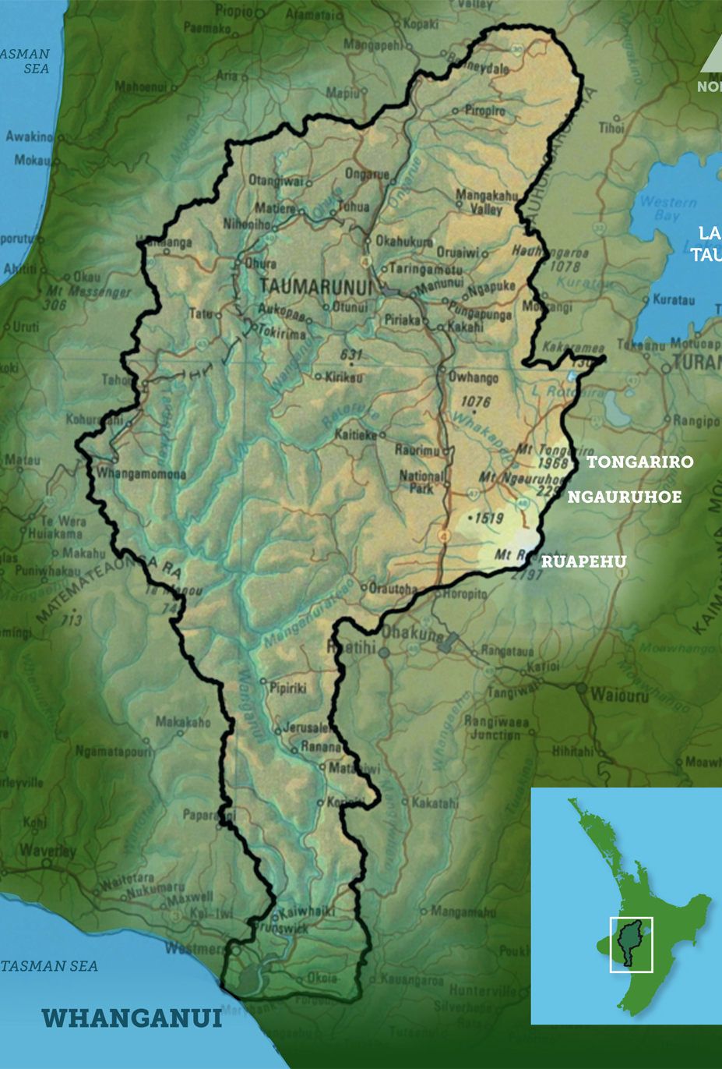
Whanganui River Catchment
290 km - third longest river
(longest navigable river) in Aotearoa
7,380 km² catchment
Mai i te Kāhui Maunga ki Tangaroa

Slide 3
Truncated Historical Context
Wanganui River Trust Act 1891 – established Wanganui River Trust Board. Preserve natural scenery and keep the river in a fit state for navigation – led to destruction of eel weirs etc
Public Works Act 1903 – preservation of scenery considered a public work – land alienation
1903 Coal Mines Amendment Act – vested beds of navigable rivers in the Crown –customary ownership of riverbed undermined
1930s-1960s Whanganui River Bed Case – claim taken by Whanganui Iwi for customary ownership of riverbed

Slide 4
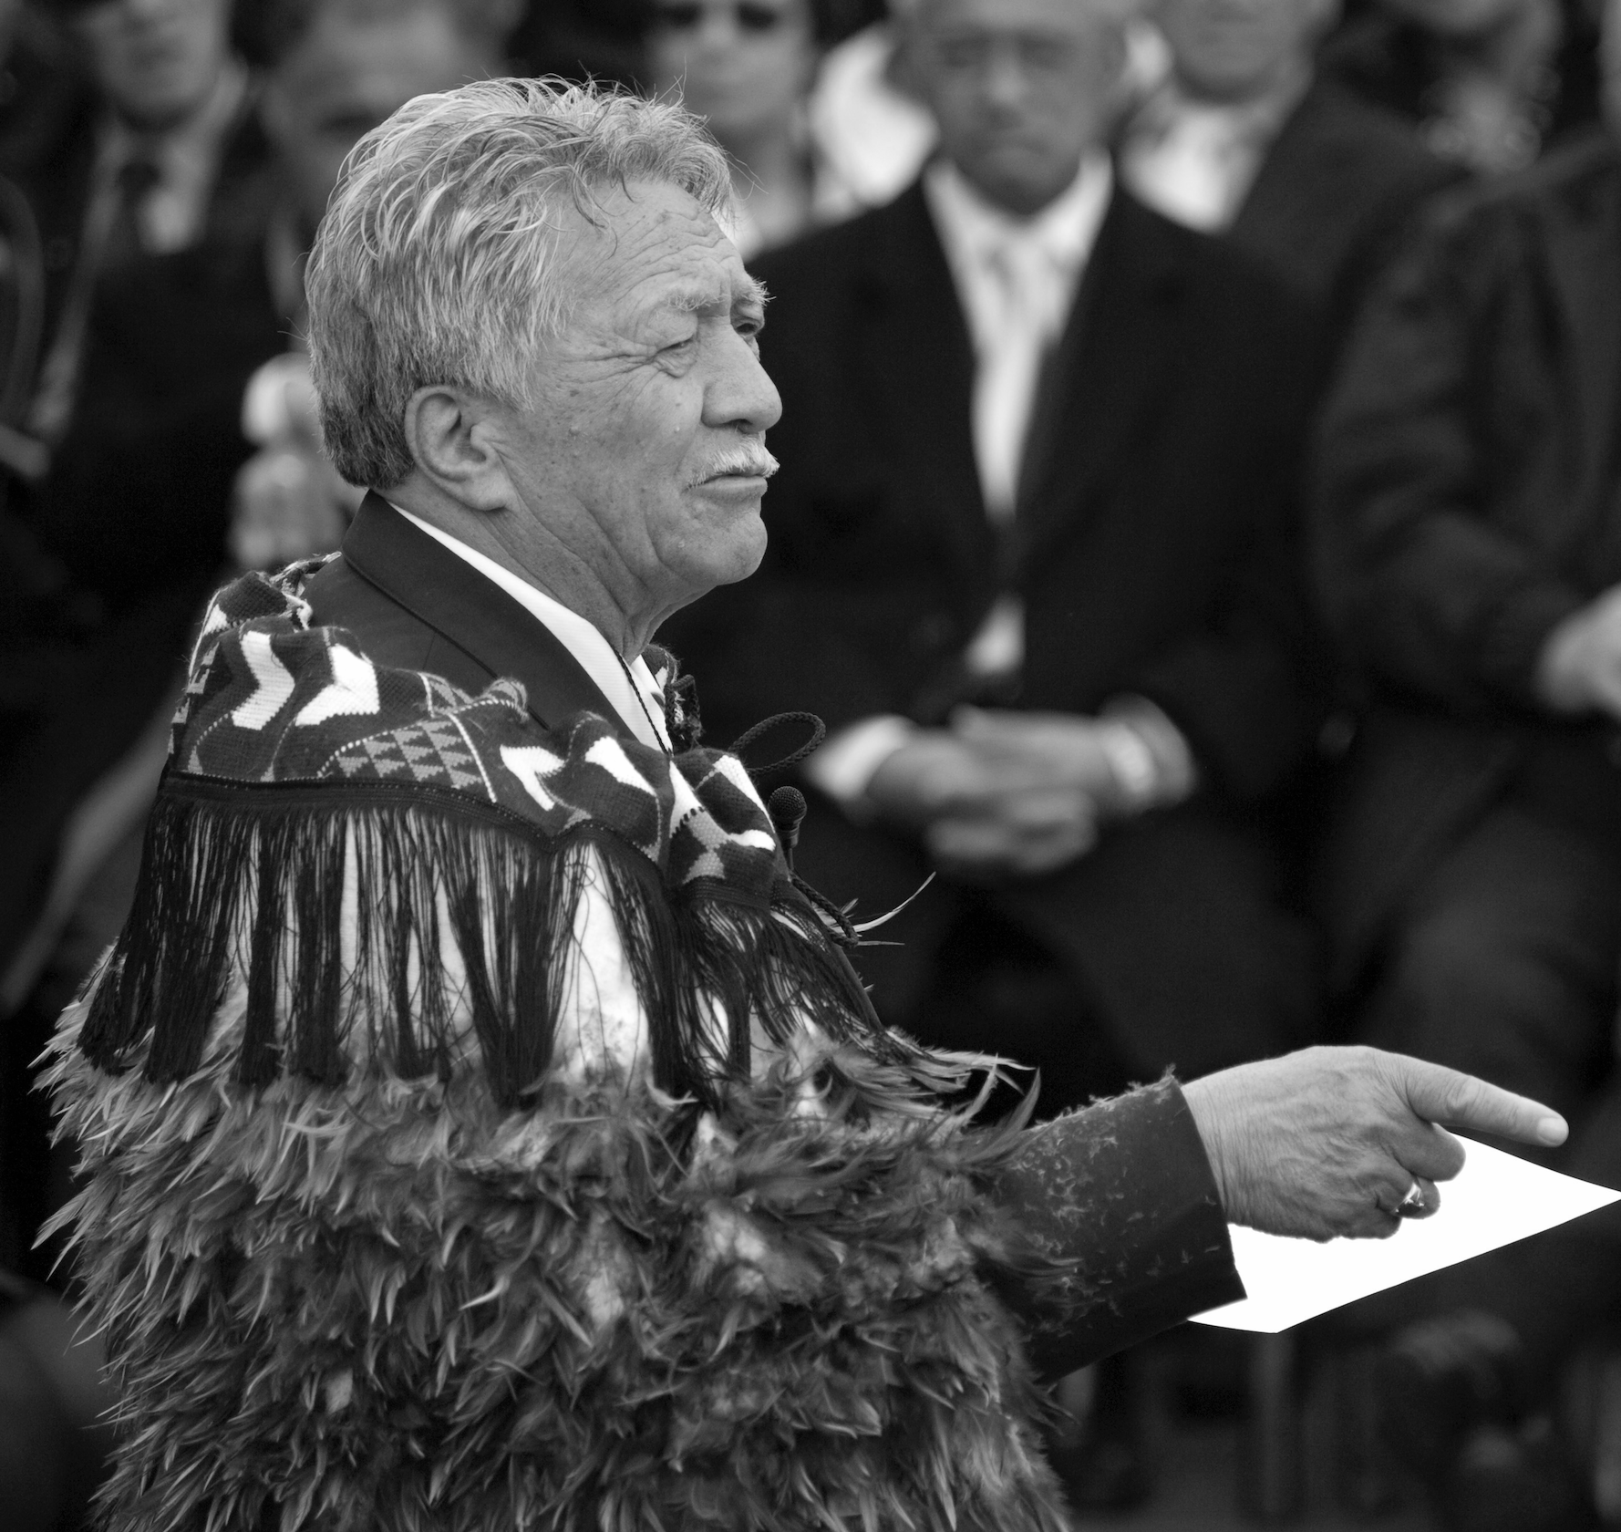
“Whanganui Iwi have sought to preserve their rights, protested, petitioned the Crown and pursued their claims….before numerous Courts, tribunals …. such litigation has often seen issues narrowed such that they are almost unrecognisable in Māori terms.”
The late Sir Archie Te Atawhai Taiaroa, (Ngāti Hauā/Ngāti Tū) describing the Whanganui Iwi perspective on their long running claims and litigation.

Slide 5
What I firstly want to do is say to the Tribunal that … our people are tired, they’re fed up, they feel embarrassed to come along continually and to say who they are, what is theirs. And you would have seen [on the site visit] some… (of) our people living along the river … getting their spiritual, their physical and their material substance from the river. Ad you see where they’re located and then having to spend over a hundred years trying to say ‘This is us, this is what we’re trying to hold onto, this is what we have for our future generations’
Transcription of oral submission by Archie Taiaroa, 19 April 1994

Slide 6
In 2017 Whanganui River was recognised at law as a living and indivisible whole, Te Awa Tupua.
At the heart of this recognition is a set of innate values called Tupua Te Kawa.
“These principles clearly demonstrate the relationship between the Whanganui River and its people, but also the interconnectedness of their sovereignty. Recognition of Maori authority in the River has correlated with recognition of the River’s own mana.”
Hsiao 2012

Slide 7
KO TE KAWA TUATAHI:
Ko te Awa te mātāpuna o te ora
The River is the source of spiritual and physical sustenance
Te Awa Tupua is a spiritual and physical entity that supports and sustains both the life and natural resources within the River and the health and wellbeing of iwi, hapū and other communities.

Slide 8
KO TE KAWA TUARUA:
E rere kau mai te awa nui mai i te kāhui maunga ki Tangaroa
The great River flows from the mountains to the sea
Te Awa Tupua is an indivisible and living whole from the mountains to the sea, incorporating the River and all its physical and metaphysical elements.

Slide 9
KO TE KAWA TUATORU:
Ko au te Awa, ko te Awa ko au
I am the River and the River is me
The iwi and hapū of the River have an inalienable interconnection with, and responsibility to, Te Awa Tupua and its health and wellbeing.

Slide 10
KO TE KAWA TUAWHĀ:
Ngā manga iti, ngā manga nui e honohono kau ana, ka tupu hei Awa Tupua
The small and large streams that flow into one another and form one River
Te Awa Tupua is a singular entity comprised of many elements and communities, working collaboratively for the common purpose of the health and wellbeing of Te Awa Tupua.

Slide 11
Te Awa Tupua (Whanganui Claims Settlement) Act 2017
Gives legal effect to and is to be interpreted in a manner that best furthers the agreements in Ruruku Whakatupua (Deed of Settlement);
Binds the Crown;
Imposes legal obligations on a range of statutory decision makers, including local government, on matters relating to the Whanganui River or activities within the catchment that affect the Whanganui River:

Slide 12
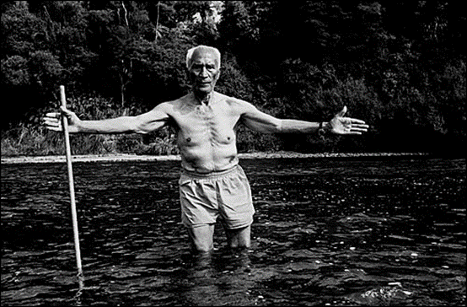
Te Awa Tupua – Legal Personality
Te Awa Tupua (Whanganui River Claims Settlement) Act, provides that:
Te Awa Tupua is a living and indivisible whole comprising the Whanganui River (including its tributaries) from the mountains to the sea including all of its physical and metaphysical elements
Te Awa Tupua is a legal person

Slide 13
Te Pā Auroa nā Te Awa Tupua – Te Awa Tupua Framework
The name of the Te Awa Tupua framework symbolises an extensive, well constructed framework for Te Awa Tupua that is fit for purpose, enduring and the responsibility of all.
Statement of intent: Te Pā Auroa is intended to:
  enable all to view and relate to Te Awa Tupua;
  ensure that Te Pā Auroa is relevant to the exercise of all statutory functions, duties or powers relating to the Whanganui River or activities in its catchment affecting the Whanganui River; and
  reflect the Crown's commitment to Te Awa Tupua and Tupua te Kawa.

Slide 14
Te Pā Auroa
Te Awa Tupua and its legal status
Tupua te Kawa
Te Pou Tupua
Te Kōpuka
Te Heke Ngahuru
Kia Matara Rawa
Te Korotete
Notes:
Te Pā Auroa comprises the following elements:
Te Awa Tupua and its legal status;
Tupua te Kawa (the Te Awa Tupua values);
Te Pou Tupua (the human face of Te Awa Tupua);
Te Heke Ngahuru ki Te Awa Tupua (the Te Awa Tupua strategy);
Te Kōpuka nā Te Awa Tupua (the Te Awa Tupua strategy group);
Kia Matara Rawa (the vesting of the Crown-owned parts of the bed of the Whanganui River in Te Awa Tupua); and
Te Korotete o Te Awa Tupua (the Te Awa Tupua fund)

Slide 15
Legal Effect
For most natural resource statutes (including preparing or changing RPS, regional plan or district plan), decision-makers must “recognise and provide for” Te Awa Tupua status and Tupua te Kawa;
For Heritage NZ Act, Public Works Act and other parts of RMA, decision-makers must “have particular regard to” Te Awa Tupua status and Tupua te Kawa;
For all statutes, decision-makers must treat the Te Awa Tupua Framework as a relevant consideration.

Slide 16
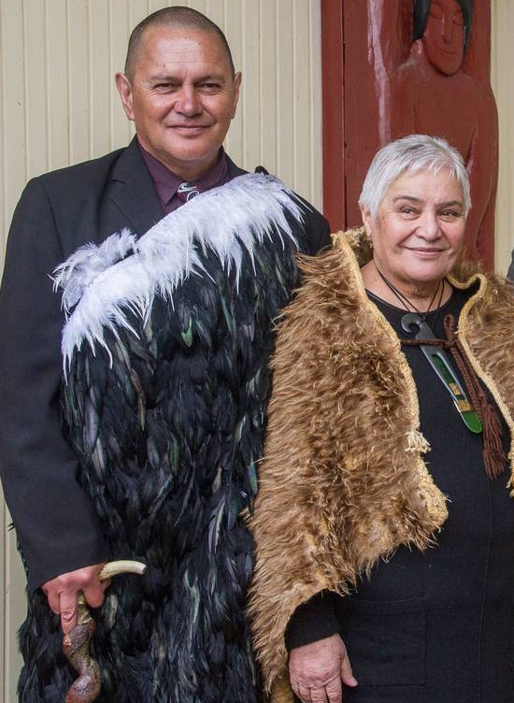
Te Pou Tupua - The human face of Te Awa Tupua
A single role comprising two persons jointly appointed by the Crown and the Iwi of the River: Dame Tariana Turia and Poukōrero, Turama Hawira.
Supported by Te Karewao
Role of Te Pou Tupua:
to uphold the Te Awa Tupua status and Tupua te Kawa;
to act and speak for Te Awa Tupua;
to promote and protect the health and wellbeing of Te Awa Tupua;
to exercise landowner functions in respect of those parts of the riverbed vested in Te Awa Tupua.
NB: there is no “Crown” rep or “iwi” rep

Slide 17
Te Kōpuka nā Te Awa Tupua
Te Kōpuka nā Te Awa Tupua - strategy group (17 persons) representing Whanganui Iwi (1), other River iwi (5), local authorities (4), DoC (1), Fish & Game (1), Genesis (1), and other interest groups (4);
  strategy group comprising representatives of Whanganui Iwi, other iwi with interests, local and central government, other key interest groups
  deemed to be a joint committee of local authorities
  purpose is to act collaboratively to advance health and wellbeing of Te Awa Tupua
  will develop, monitor the implementation of, and review Te Heke Ngahuru ki Te Awa Tupua (strategy)
  provides a forum for discussion of River issues

Slide 18
Te Heke Ngahuru Ki Te Awa Tupua
A whole of River strategy document to guide the future environmental, cultural, social and economic health and wellbeing of Te Awa Tupua
Must identify issues, provide strategies and recommend actions
Collaboratively developed by Te Kōpuka
Legal weighting: decision-makers under natural resources statutes (see list in Schedule 2 of Act):
  must “have particular regard to” Te Heke Ngahuru,
  but may, in their discretion, adopt or implement Te Heke Ngahuru in whole or in part

